Slide 1

React
Routing & Layout

Slide 2
# Table of Contents
Routing: React Router
Layout
Refactor: AddMovieForm

Slide 3
Routing

Slide 4
# Routing
Mengarahkan user ketika mengakses suatu url.
Previously: Only one page and haven’t added other pages.
React doesn’t provide default routing.
Solution: React Router.

Slide 5
# React Router
Fully-featured (client & server-side) routing library for React.
Runs on: Web, Server (Node), React Native.
Standard library for routing.
Referensi: React Router - Home.

Slide 6
# Install
Third party.
Not provided by default.
Install: npm install react-router-dom.
Referensi: React Router - Installation.

Slide 7
# Configuring Routes
Connect App to the browser’s URL: <BrowserRouter/>.
Add navigation/link: <Link />.
Add routes: <Routes /> and <Route />.
Referensi: React Router - Tutorial.

Slide 8
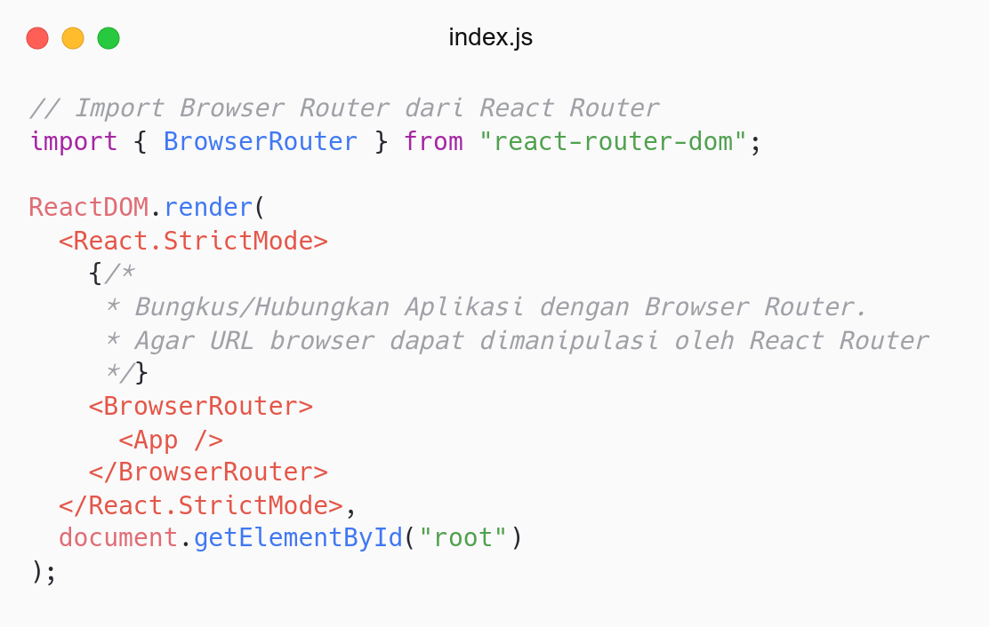
Connect App to URL.
Use <BrowserRouter />.
Wrap <App /> within.

Slide 9
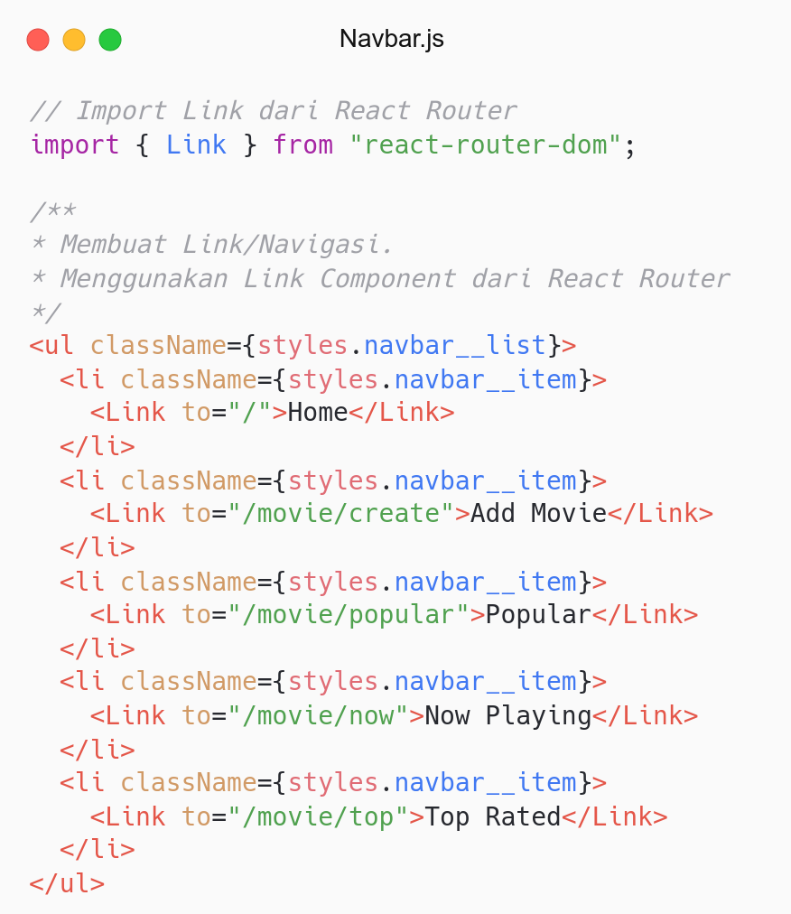
<Link /> pengganti <a />.
Create Link/Navigation.
Use <Link />.
Props to: Mengarahkan user (href).

Slide 10
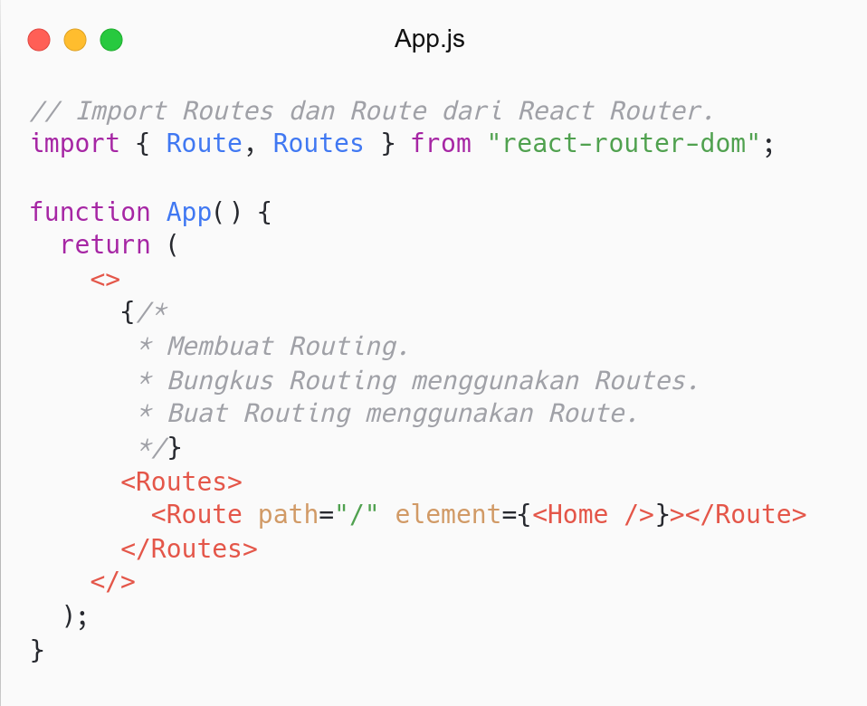
Create Routing.
Wrap with <Routes />.
Use <Route />.
Props path: Menentukan alamat.
Props element: Render element/component.

Slide 11
Layout

Slide 12
# Pages
Membuat halaman yang berkaitan dengan movie.
Movie folder: src/page/movie.
Pages:
Create.js: Menambahkan movie.
NowPlaying.js: Menampilkan movie sedang diputar.
Popular.js: Menampilkan popular movie.
TopRated.js: Menampilkan top movie.

Slide 13
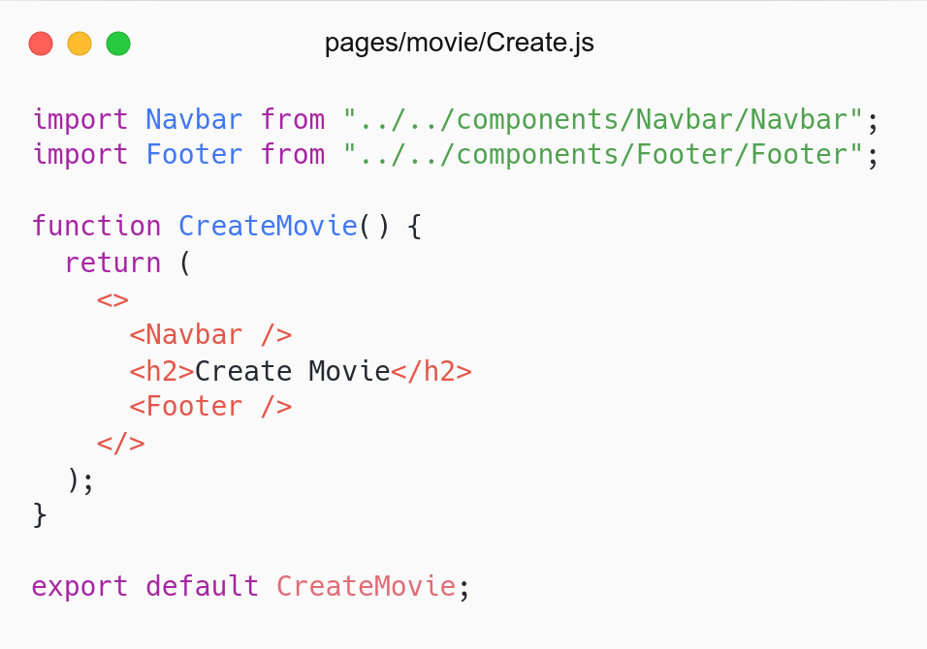
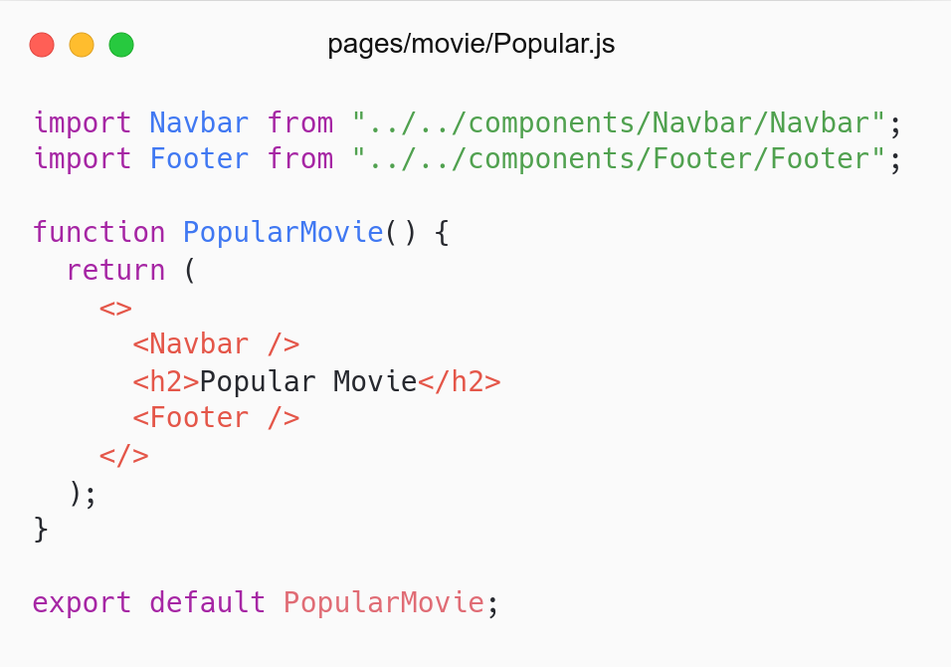
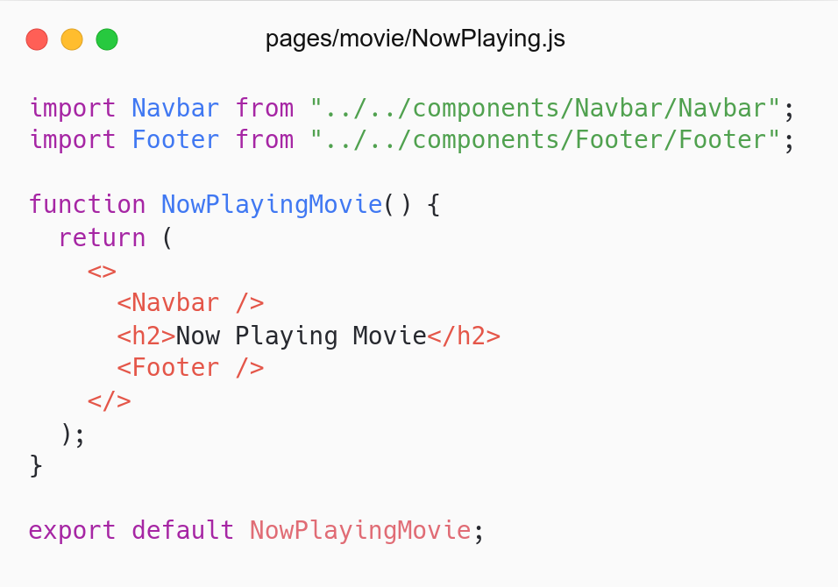
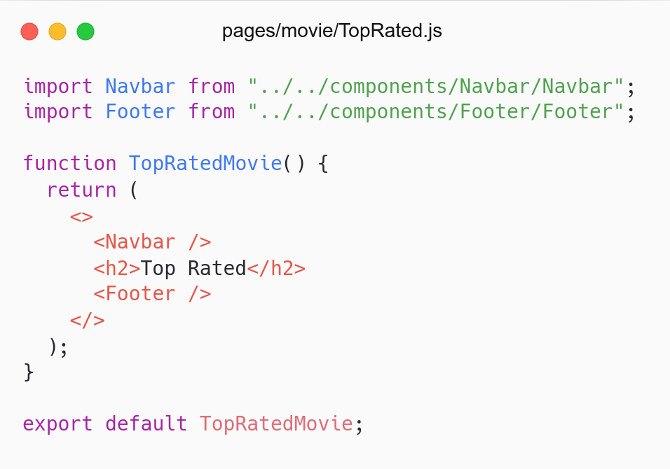

Slide 14
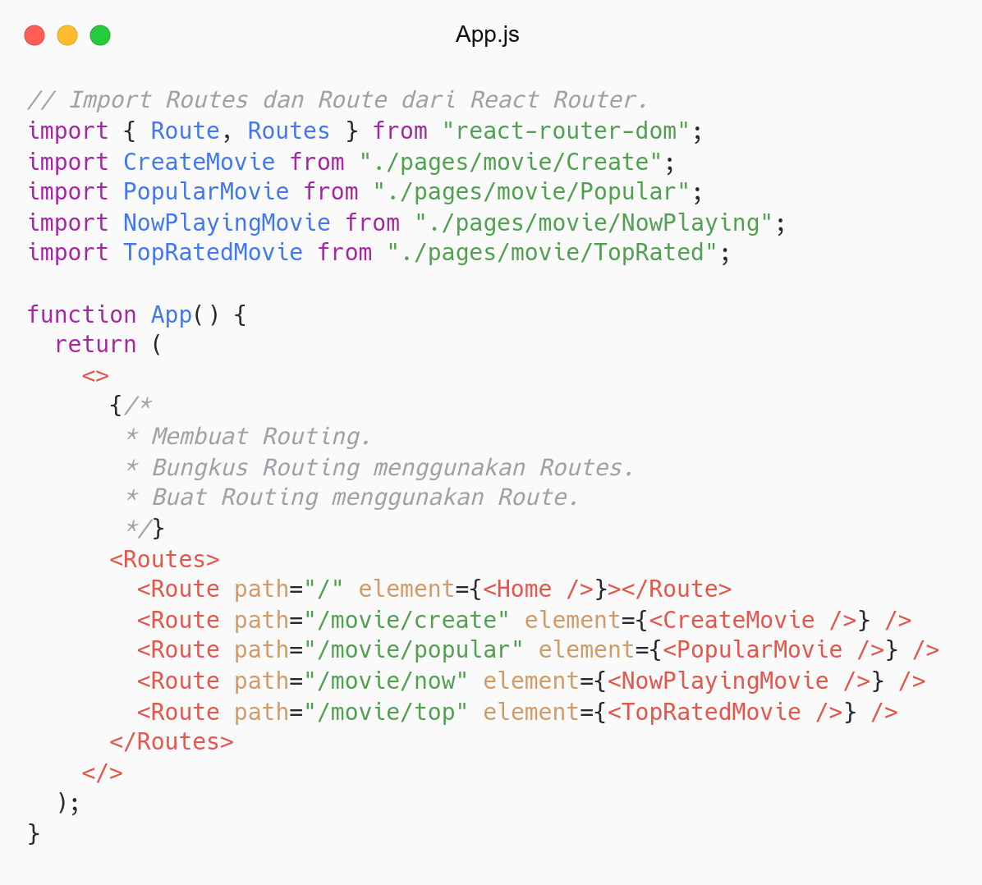
Add other routes.
Use <Route />.

Slide 15
Problem: Every page import navbar & footer.
Solution: Create <Layout />.

Slide 16
# Layout
Digunakan agar setiap halaman tampil konsisten.
Tidak ada cara khusus untuk membuat layout (preference).
Use Composition Model to create Layout
Layout: src/Layout/index.js.
Referensi: React - Composition.

Slide 17
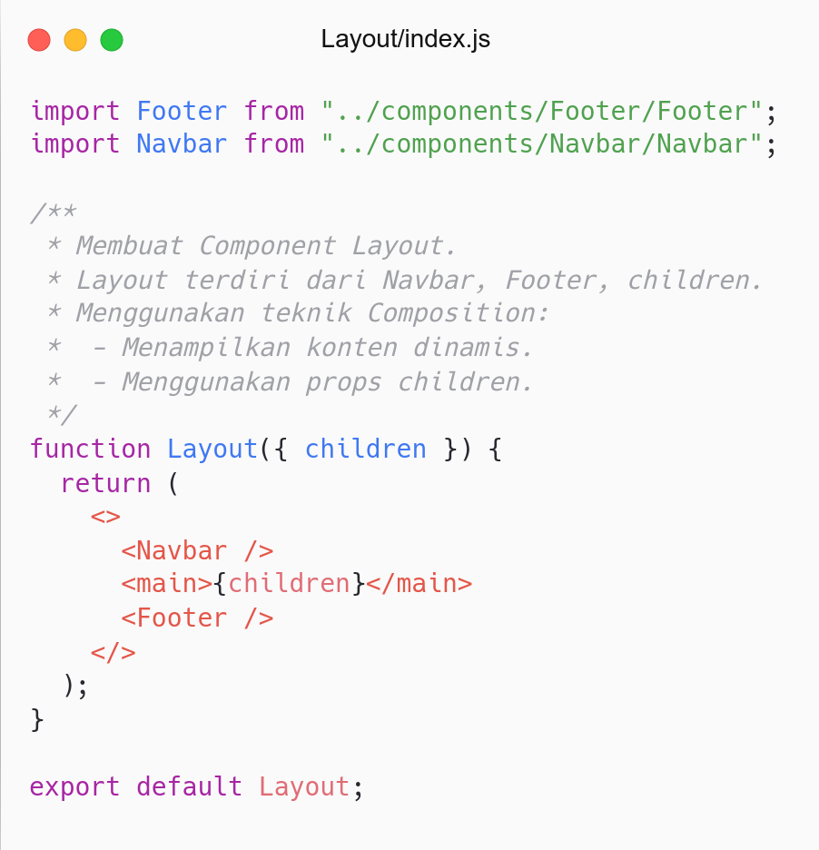
Membuat <Layout />.
Menggunakan Composition: Containment.
Props children: Menampung element/konten.

Slide 18
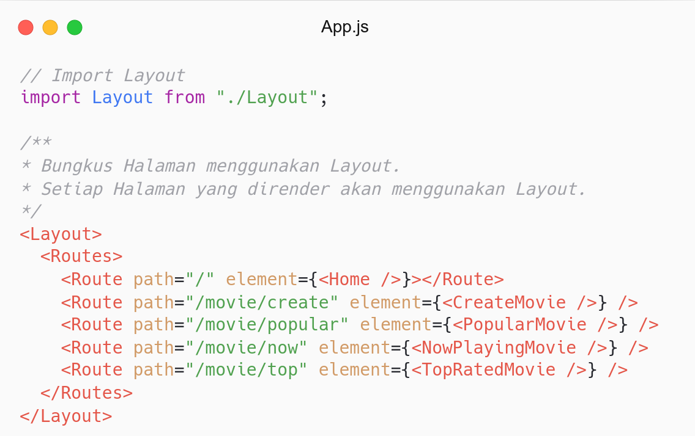
Menggunakan <Layout /> di <App />.
Bungkus halaman dengan <Layout />.
Setiap halaman menggunakan layout yang sama (konsisten).

Slide 19
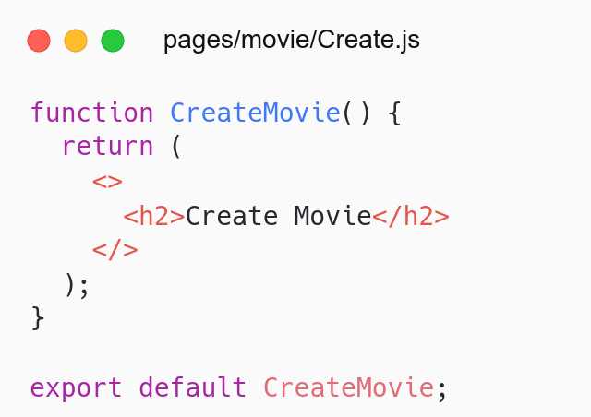
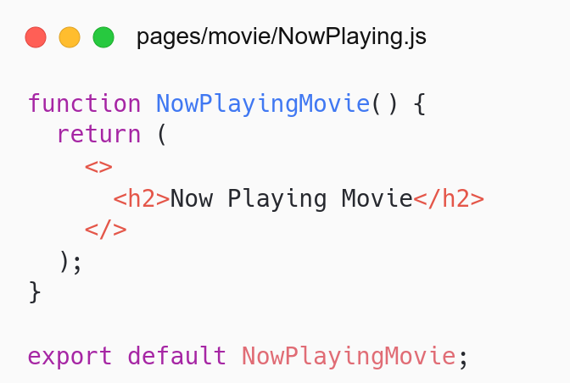
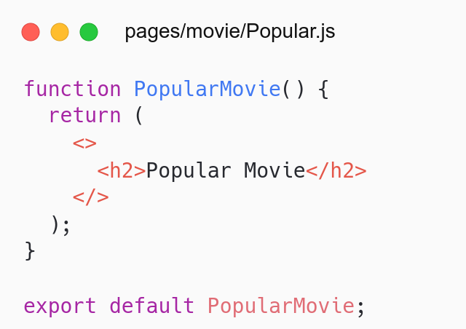
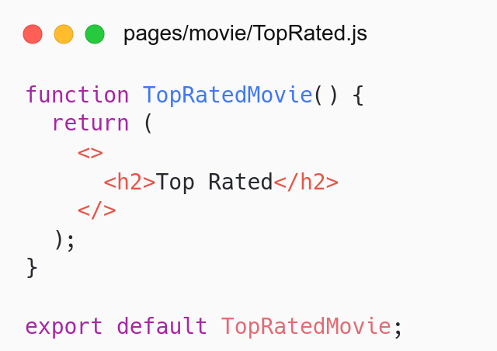
Each page uses same layout.
No need to import navbar & footer.

Slide 20
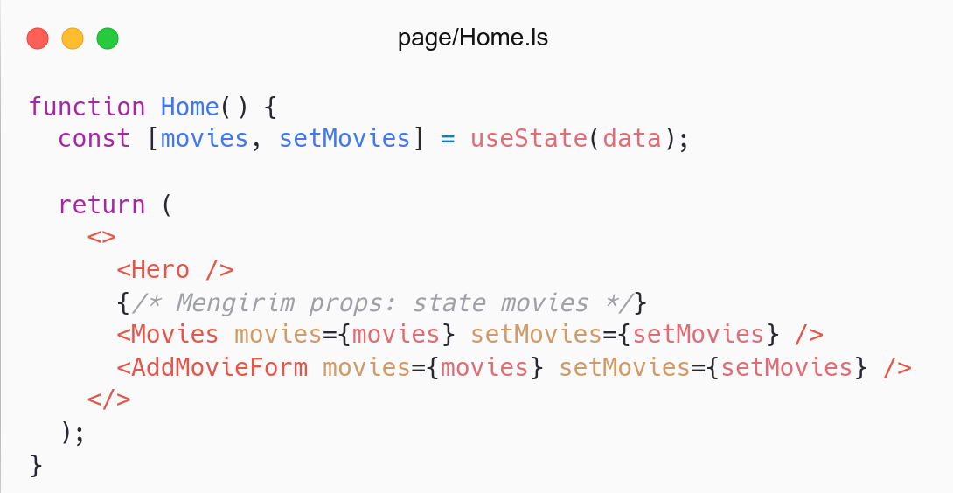
Update <Home />.

Slide 21
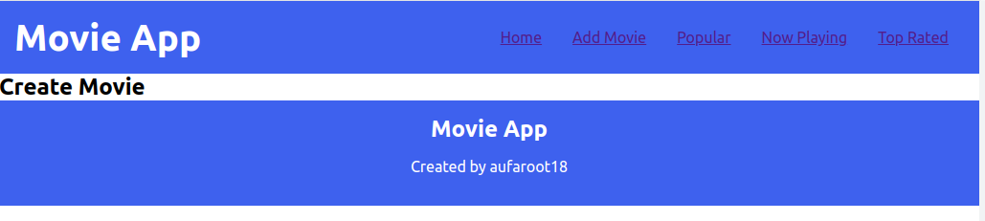
Problem: Main content on each page too wide.
Solution: <Container />.

Slide 22
# Container
Membuat component Container.
Handle konten main yang terlalu lebar.
Component: components/Container/index.js
Referensi: React- Forms.

Slide 23
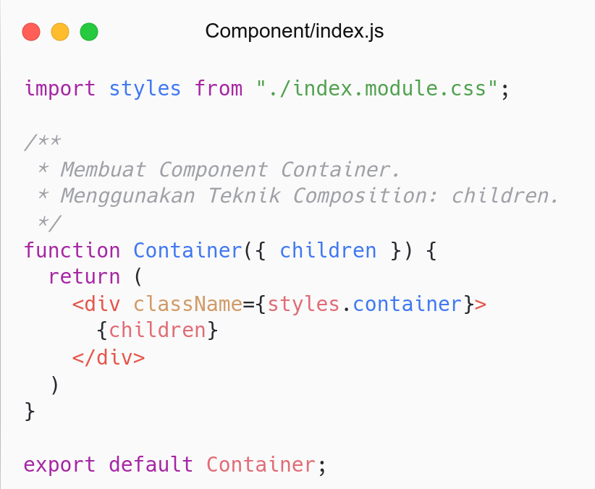
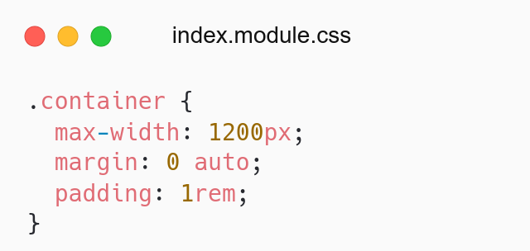
Membuat <Container />.
Menampilkan konten dinamis di dalam <Container />.
Menggunakan props children.
Memberikan style ke <Container />.
Membatasi lebar maksimal 1200px.
Set margin ke tengah.

Slide 24
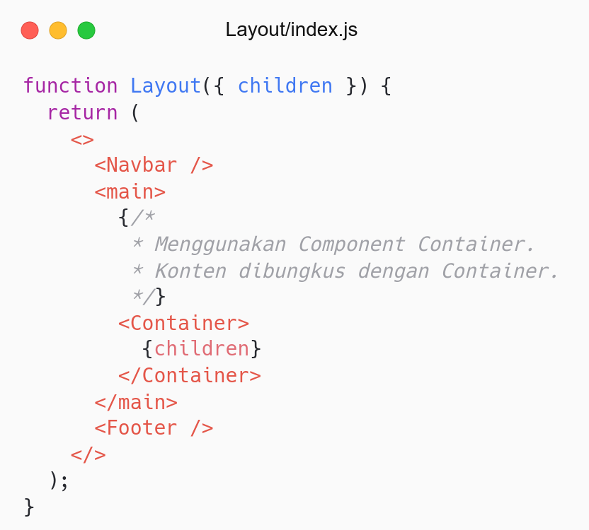
Menggunakan <Container /> di <Layout />.
Bungkus children (halaman) dengan <Container />.

Slide 25
Refactor

Slide 26
# Refactor
Clean code: Function should do one thing.
Handle multiple input.

Slide 27
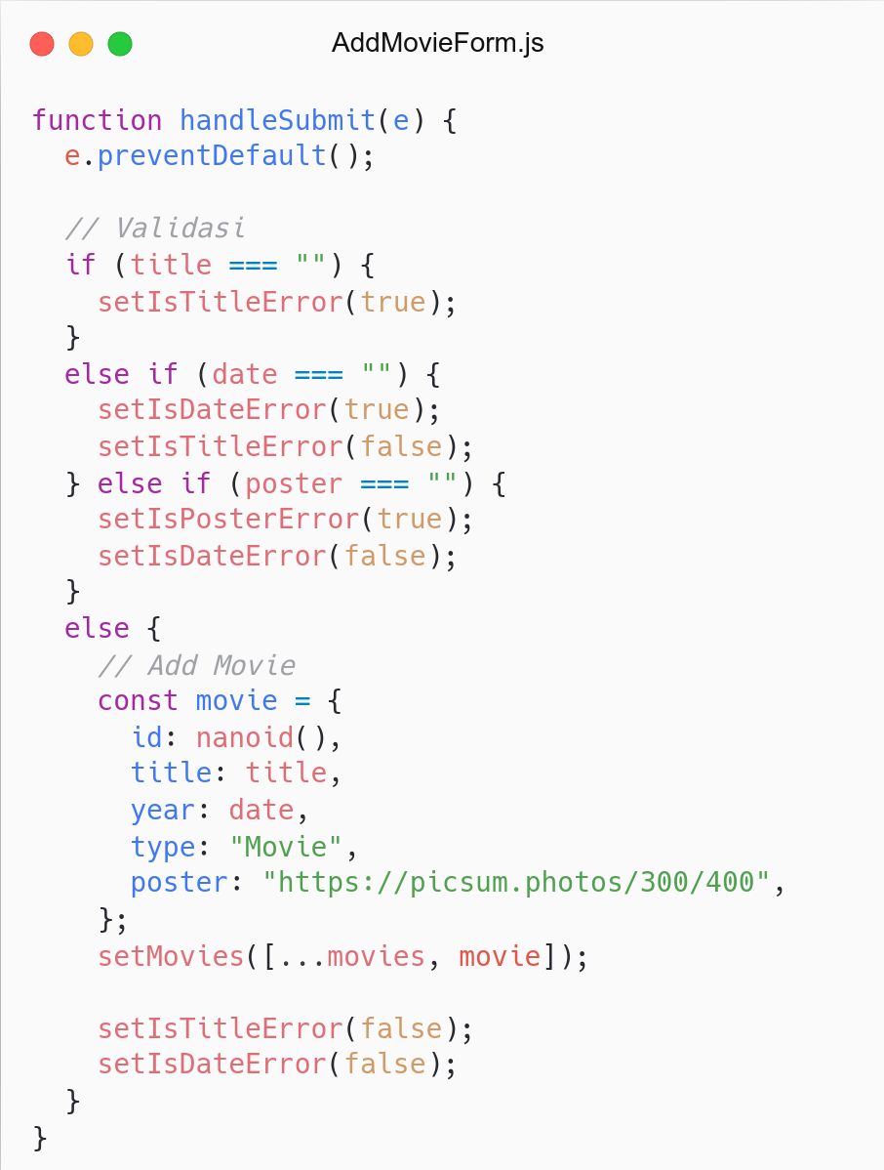
How many jobs in the function?
Clean Code: Function should do one thing:
validate function
addMovie function
resetForm function

Slide 28
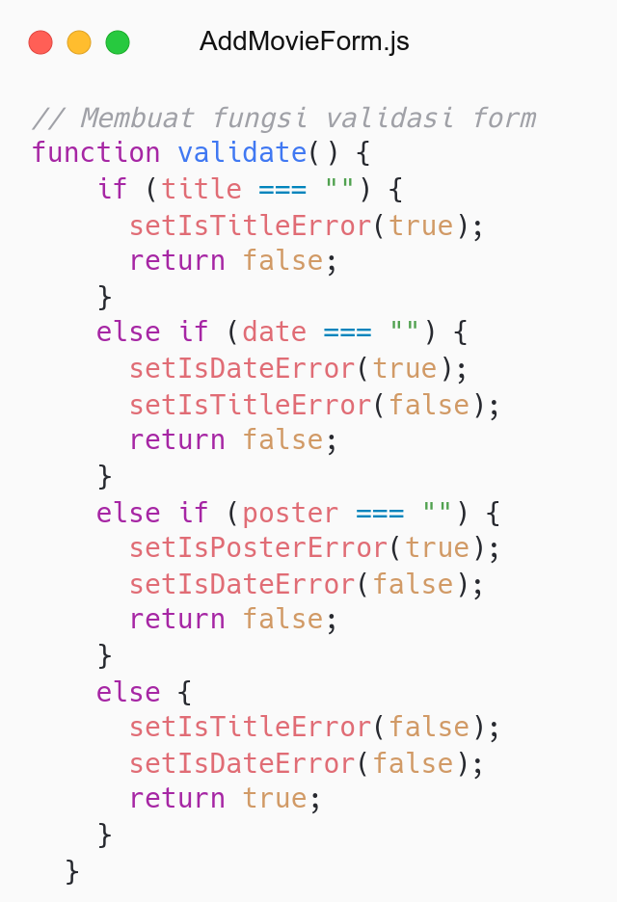
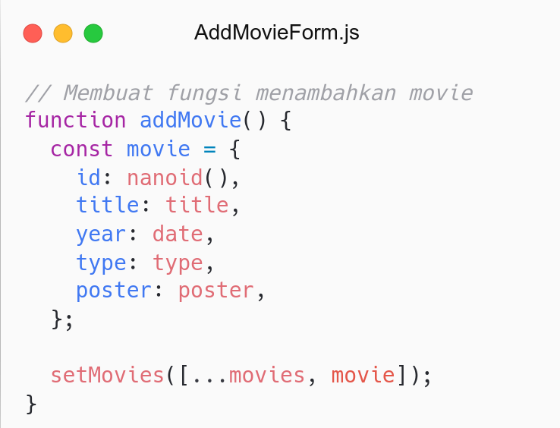

Slide 29
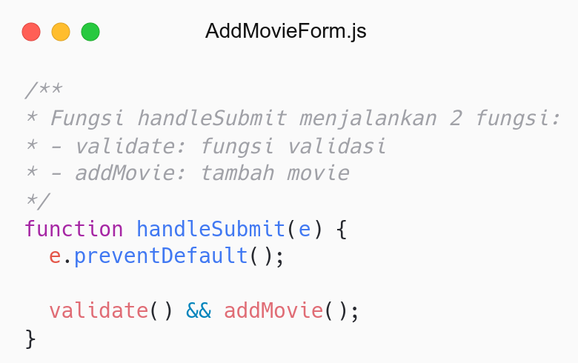
Update handleSubmit function.
Looks cleaner.
Clean Code: Function should do one thing.

Slide 30
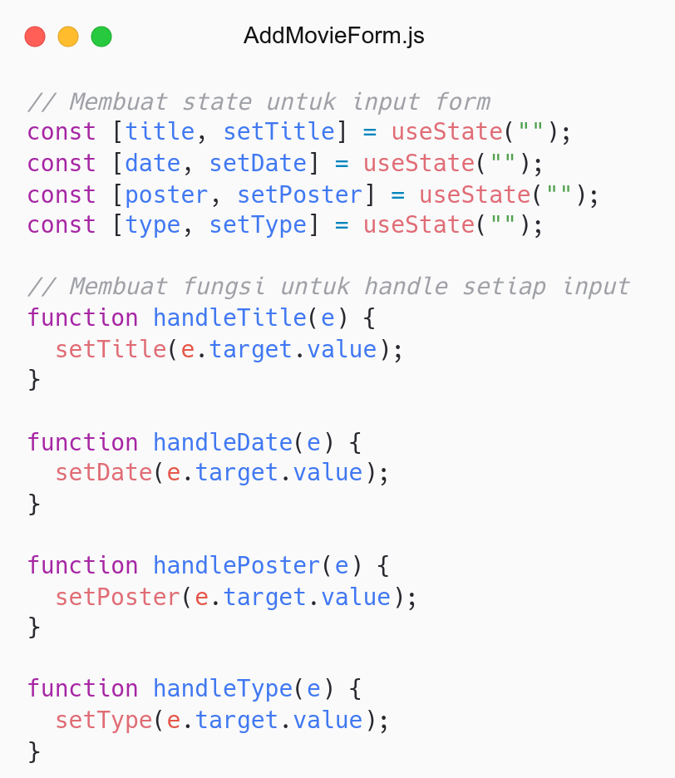
Problem:
One input has one state and handler function
The more inputs, the more state & handler.
Solution:
Handle multiple input (one state).
Object: store values.
Spread operator: update object.

Slide 31
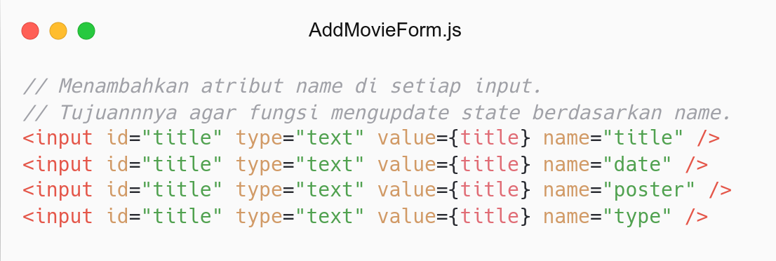
Menambahkan atribut name.
Atribut name untuk memberi nama input.
Tujuannya agar fungsi mengupdate state berdasarkan name.

Slide 32
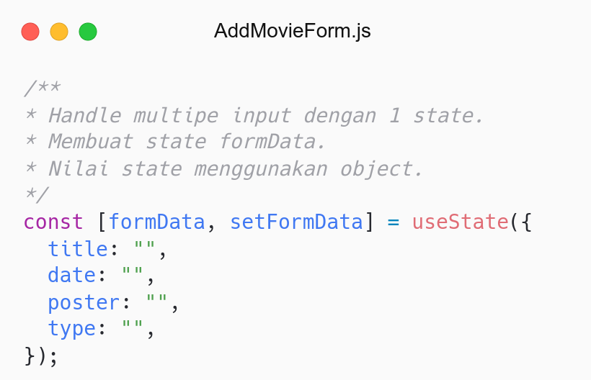
Handle multiple input.
Membuat state formData.
Nilai state berupa object.

Slide 33
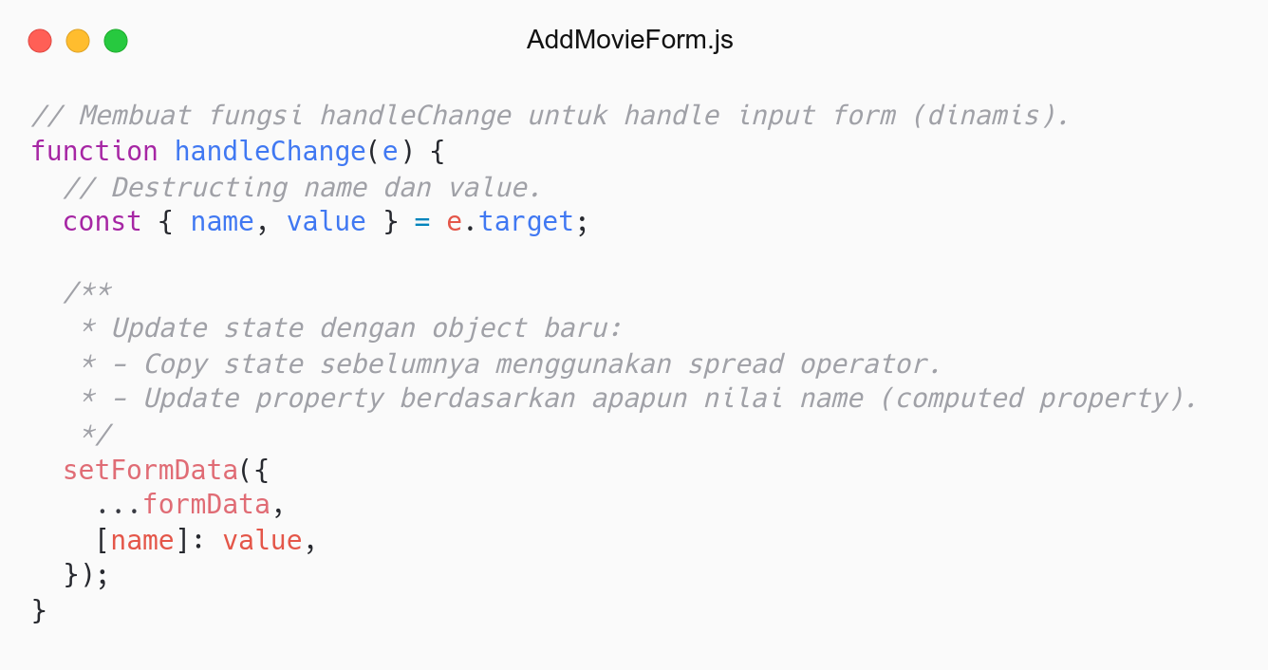
Membuat fungsi handleChange.
Handle semua input form.
Update state berdasarkan nilai name.

Slide 34
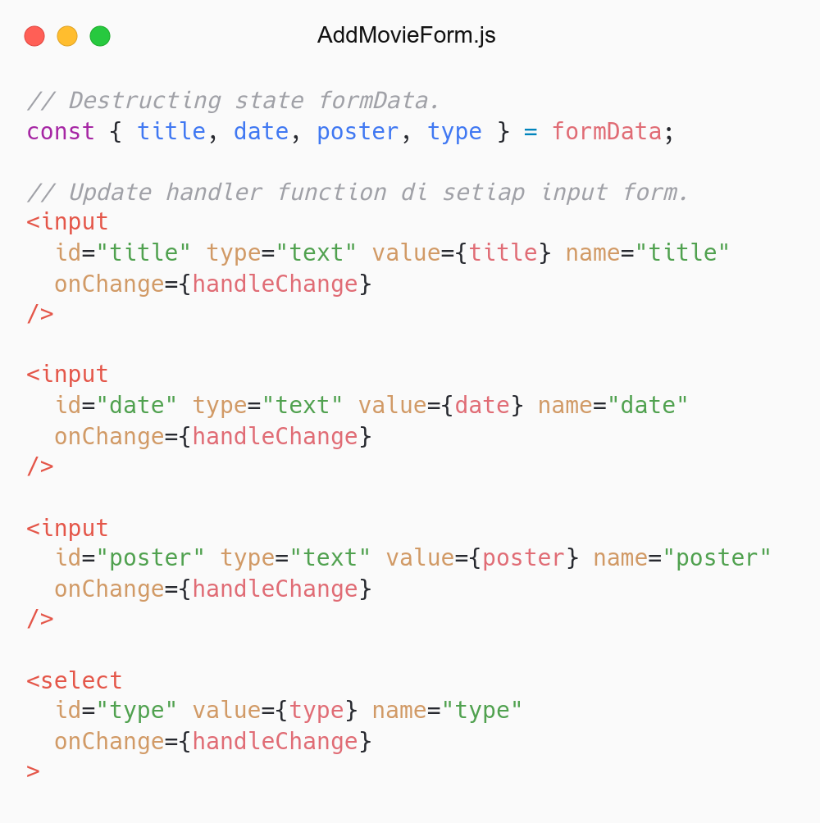
Looks cleaner.
Just one state and handler function.
No need any other handler functions.

Slide 35
QnA

Slide 36
Take Away

Slide 37
# TODO
Problem: 1 error 1 state.
Refactor multiple error to use one state.
Hint:
Gunakan object.
Gunakan spread operator.

Slide 38
# Assignment
Push code to Repository Github (use branch for task management).
No zip and don’t push node_nodules folder.
Submit link repository to elena.
Kamis: 21 April 2022, Link Elena.
Jumat: 23 April 2022, Link Elena.

Slide 39
Attendance

Slide 40
Thanks

